Slide 1
WA Education Summit
AI & Assessment
Perth
1 August - 2024

Slide 2
salakas.me/uluru
Digital Pedagogy
Enabling learning experiences that were previously impossible

Slide 3
What is the purpose of AI?
Notes:
Who pays the bills, why?

Slide 4
Image or Graphic
The Odyssey of Assessment in Education
How can we, as educators, navigate disruptions and stay true to our values, just as Odysseus did on his journey home?
Notes:
The Odyssey is more than a story of adventure; it is a profound tale of finding one's way home, returning transformed by experiences. This epic mirrors our journey in education. We, as educators and leaders, must find ways to reintegrate essential elements—student outcomes, the learning cycle, and modern technologies—while facing and overcoming societal and technological disruptions. Just as Odysseus faced numerous trials and challenges guided by his unwavering loyalty to his values and loved ones, we too must navigate the ever-evolving landscape of education with courage and commitment to our core values. This journey demands that we adapt and innovate without losing sight of our primary mission: supporting and enhancing student learning and outcomes.

Slide 5
What is the purpose of schools?
Notes:
The Budget 2024-25 includes an estimated $126.4 billion over 2024–25 to 2027–28 in recurrent school funding.
Values — why it's important that you know them so your AI’s and your innovations can align with them. All innovations should be downstream of them.

Slide 6
Types of Assessment
There are three primary types of assessments: diagnostic, formative, and summative:
Diagnostic assessments are conducted to identify students' strengths, weaknesses, knowledge, and skills prior to instruction, forming a basis for tailored educational strategies.
Formative assessments are integrated into the learning process, offering ongoing feedback to teachers about student progress.
Summative assessments are conducted at the conclusion of a course, program, unit of work, or a specific timeframe to gauge students' overall achievement and understanding of set curriculum standards or learning objectives.
The exception to this rule of three are assessments that review school or system performance. These are the PISA-style assessment tasks that rank a country against others or provide data for system comparison
Notes:
Who pays the bills, why?

Slide 7
Why Assess?
Without effective assessment, the essence of learning remains shrouded in mystery. It is only through the power of astute evaluation that we can truly discern if the seeds of knowledge have taken root in the minds of our learners!
(Masters, 2013)
Notes:
Who pays the bills, why?

Slide 8
Will AI be good for Assessment?
The real WIN here is that this change to assessment design is actually forcing teachers to embrace the effective assessment pedagogical practice that researchers and academics have been championing for some time. In an odd twist, the emergence of AI may be the catalyst that drives humanity in future assessable tasks, minimising rote learning and pushing students into higher-order thinking.
(Masters, 2013)
Notes:
Who pays the bills, why?

Slide 9
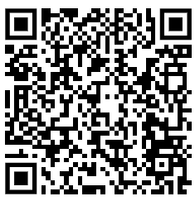
Take care with suitors and sirens
How can we ensure that AI tools align with our educational values and truly benefit our students and communities?

Slide 10
Is AI cheating???
Side note discussion point:
-AI and cheating
-media hype
-Assessment pedagogy
-The MASSIVE risk is actually the danger of ‘AI GRIFTERS’

Slide 11
What AI tools should I use?
Notes:
The Budget 2024-25 includes an estimated $126.4 billion over 2024–25 to 2027–28 in recurrent school funding.
Values — why it's important that you know them so your AI’s and your innovations can align with them. All innovations should be downstream of them.

Slide 12
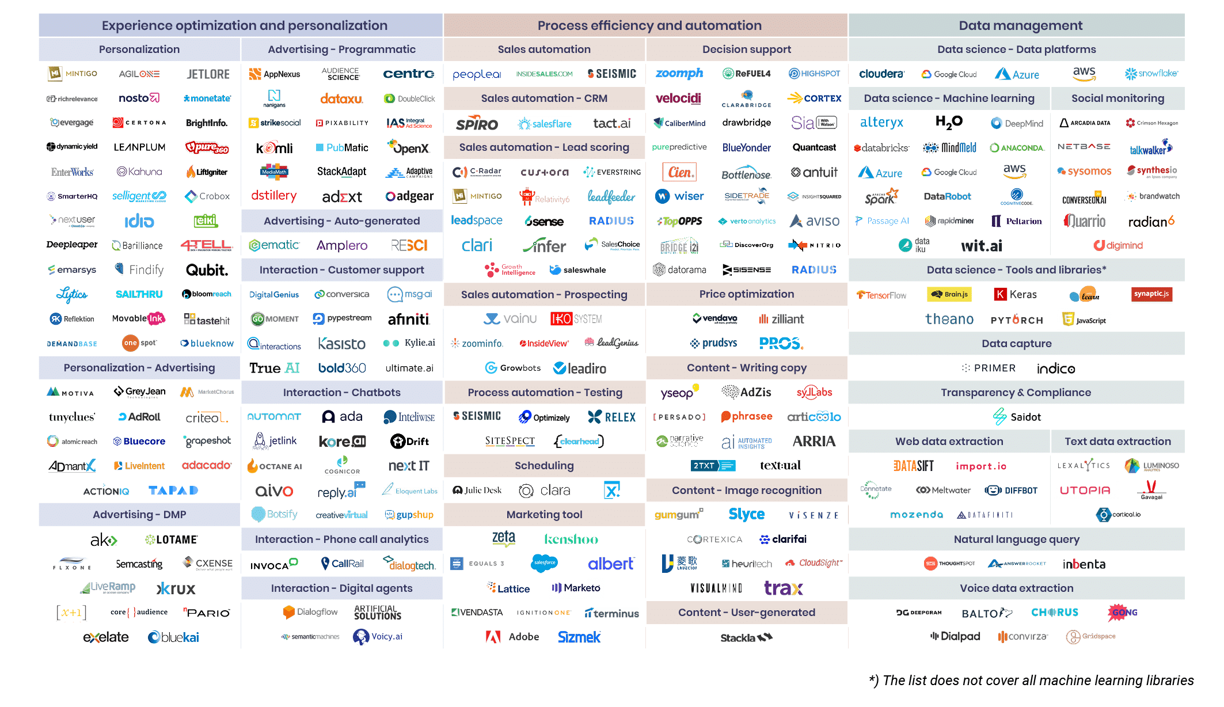
Source: https://www.avaus.com/news/the-ai-marketing-landscape-is-growing-at-the-speed-of-light/
Notes:
Meanwhile, on the other side of the ocean, Odysseus and his crew face a perilous challenge: the Sirens. These mythical creatures lure sailors with their enchanting song, promising great rewards but leading to doom. Odysseus, wise and forewarned by the sorceress Circe, devises a plan to safely navigate this danger. He orders his crew to plug their ears with beeswax so they cannot hear the Sirens' song, and he has himself tied to the mast of the ship, allowing him to hear the song without being able to act on its allure. This precautionary approach ensures they stay the course and avoid catastrophe. Remarkably, Odysseus becomes the only person to hear the Sirens’ song and survive, ultimately leading to the Sirens' demise as they lose their power when their victims resist.
This story offers a powerful analogy for navigating the Gartner Hype Cycle, especially concerning AI and other emerging technologies in education. Just as Odysseus anticipated and planned for the Sirens’ temptation, we must anticipate the cycle of hype and disillusionment that accompanies new technologies.
Key Lessons:
Forewarned is Forearmed: Odysseus was informed by Circe about the Sirens and prepared accordingly. Similarly, understanding the Gartner Hype Cycle prepares us for the stages of excitement, disappointment, and eventual maturity that new technologies undergo.
Strategic Patience: Just as Odysseus used beeswax and binding to safely navigate the Sirens, we should adopt a cautious and measured approach to new technologies, avoiding the rush to adopt at the peak of inflated expectations.
Staying the Course: Odysseus’ crew stayed on course by following his plan. We too must remain steadfast, focusing on our core values and long-term goals rather than being swayed by the latest hype.
Disillusionment as a Filter: The disillusionment phase will weed out those technologies and companies that cannot deliver on their promises. Like the Sirens losing their power, ineffective tools will fall away, leaving those who provide genuine, value-aligned benefits to stand out.
Values and Alignment: During the trough of disillusionment, look for partners and technologies that align with your values and demonstrate real benefits. These are the ones that will lead us to the slope of enlightenment and the plateau of productivity.
By understanding and applying these lessons, we can navigate the complex landscape of AI in education with wisdom and foresight, ensuring that we adopt technologies at the right time and in the right way, maximizing their benefits for our students and communities.

Slide 13
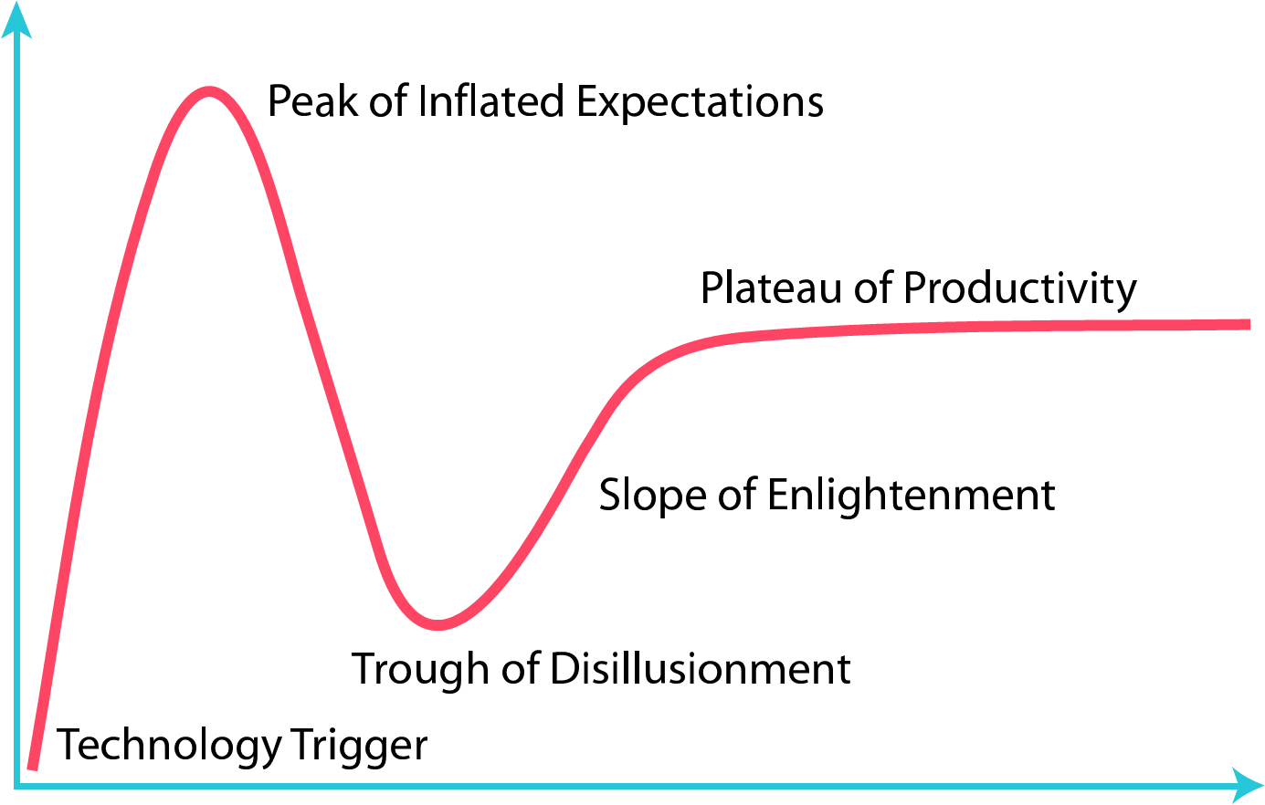
Navigating the Gartner Hype Cycle Strategically
Visibility
Time
Notes:
Meanwhile, on the other side of the ocean, Odysseus and his crew face a perilous challenge: the Sirens. These mythical creatures lure sailors with their enchanting song, promising great rewards but leading to doom. Odysseus, wise and forewarned by the sorceress Circe, devises a plan to safely navigate this danger. He orders his crew to plug their ears with beeswax so they cannot hear the Sirens' song, and he has himself tied to the mast of the ship, allowing him to hear the song without being able to act on its allure. This precautionary approach ensures they stay the course and avoid catastrophe. Remarkably, Odysseus becomes the only person to hear the Sirens’ song and survive, ultimately leading to the Sirens' demise as they lose their power when their victims resist.
This story offers a powerful analogy for navigating the Gartner Hype Cycle, especially concerning AI and other emerging technologies in education. Just as Odysseus anticipated and planned for the Sirens’ temptation, we must anticipate the cycle of hype and disillusionment that accompanies new technologies.
Key Lessons:
Forewarned is Forearmed: Odysseus was informed by Circe about the Sirens and prepared accordingly. Similarly, understanding the Gartner Hype Cycle prepares us for the stages of excitement, disappointment, and eventual maturity that new technologies undergo.
Strategic Patience: Just as Odysseus used beeswax and binding to safely navigate the Sirens, we should adopt a cautious and measured approach to new technologies, avoiding the rush to adopt at the peak of inflated expectations.
Staying the Course: Odysseus’ crew stayed on course by following his plan. We too must remain steadfast, focusing on our core values and long-term goals rather than being swayed by the latest hype.
Disillusionment as a Filter: The disillusionment phase will weed out those technologies and companies that cannot deliver on their promises. Like the Sirens losing their power, ineffective tools will fall away, leaving those who provide genuine, value-aligned benefits to stand out.
Values and Alignment: During the trough of disillusionment, look for partners and technologies that align with your values and demonstrate real benefits. These are the ones that will lead us to the slope of enlightenment and the plateau of productivity.
By understanding and applying these lessons, we can navigate the complex landscape of AI in education with wisdom and foresight, ensuring that we adopt technologies at the right time and in the right way, maximizing their benefits for our students and communities.

Slide 14
Image or Graphic
Between Scylla and Charybdis— Rethinking Assessment with the PRISM Method
Why do we assess?
How can we navigate the challenges of modern assessment?
Notes:
Odysseus faced numerous trials on his journey, each testing his strength, cunning, and resilience in different ways. For example, his encounter with Scylla and Charybdis required quick thinking and strategic decision-making to navigate between a rock and a hard place. These challenges can be seen as various forms of assessment that tested his skills and adaptability. Scylla was a six-headed monster that lived on one side of a narrow strait. Charybdis was a massive whirlpool situated on the other side of the strait. Odysseus had to steer his ship through this perilous passage. If he sailed too close to Scylla, he risked losing six of his men to her heads. If he sailed too close to Charybdis, the entire ship could be sucked into the whirlpool and destroyed. Odysseus chose to navigate closer to Scylla, sacrificing a few men to ensure the survival of the majority. This decision required careful risk assessment and strategic thinking.
In modern education, we need to rethink our assessment methods to reflect the diversity of student abilities and learning styles. The PRISM method offers a structured approach to achieve this by focusing on Purposeful, Responsive, Integrated, and Secure methodologies.
The PRISM method involves:
Purposeful Assessment: Focusing on clear objectives and aligning assessments with curriculum content.
Responsive Feedback: Emphasising the role of feedback in learning, using AI to provide real-time, personalised insights while ensuring teacher oversight.
Integrated Approach: Combining AI and human elements to create tasks that are engaging and challenging, encouraging higher-order thinking.
Secure Methodology: Prioritising data protection and privacy to maintain trust and integrity in the assessment process.
Odysseus’s journey highlights the importance of adaptability and continuous learning. Similarly, our assessment methods must evolve to meet the diverse needs of students, leveraging technology to enhance learning outcomes.
By adopting the PRISM method, we can create assessments that are more engaging, equitable, and effective, ensuring that every student has the opportunity to demonstrate their abilities in meaningful ways.

Slide 15
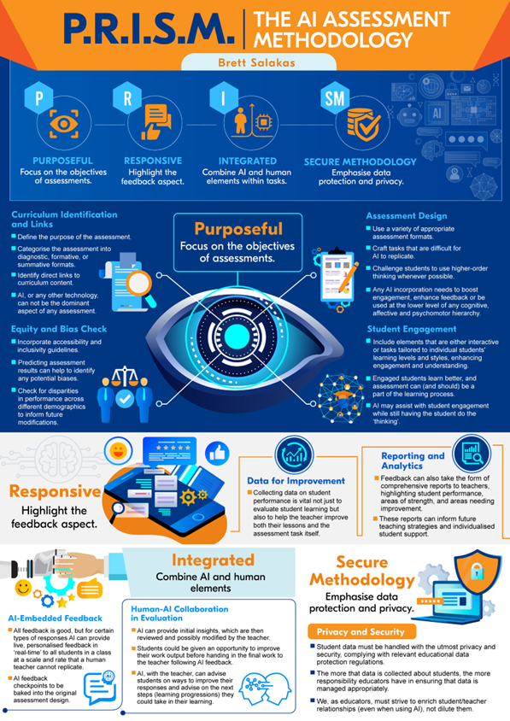
PRISM

Slide 16
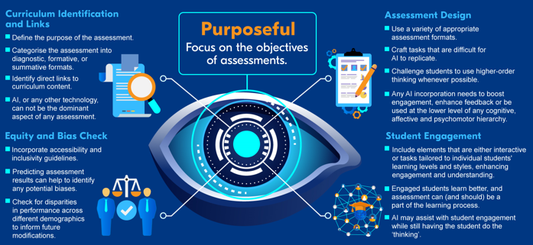
PRISM

Slide 17
PRISM

Slide 18
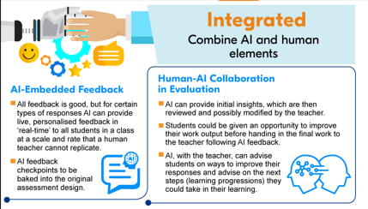
PRISM

Slide 19
Image or Graphic
Harnessing tools for classroom success
What are some practical AI-enabled edtech tools that are available now to achieve educational success?
Notes:
When trapped in the cave of Polyphemus, Odysseus crafted a sharp stake from a wooden stick to blind the Cyclops and escape. This resourcefulness and ingenuity highlight the importance of using available tools effectively to overcome challenges. In modern classrooms, educators have access to a variety of powerful tools and technologies. By harnessing these tools strategically, we can enhance learning experiences and outcomes. The key is to be innovative and resourceful, and use what’s available in the moment, just as Odysseus was able to in his time of need.

Slide 20
Example
#1
Adobe Podcast

Slide 21
Example
#2
snorkl

Slide 22
Example
#3
*study prep
fliki
*Sora is coming

Slide 23
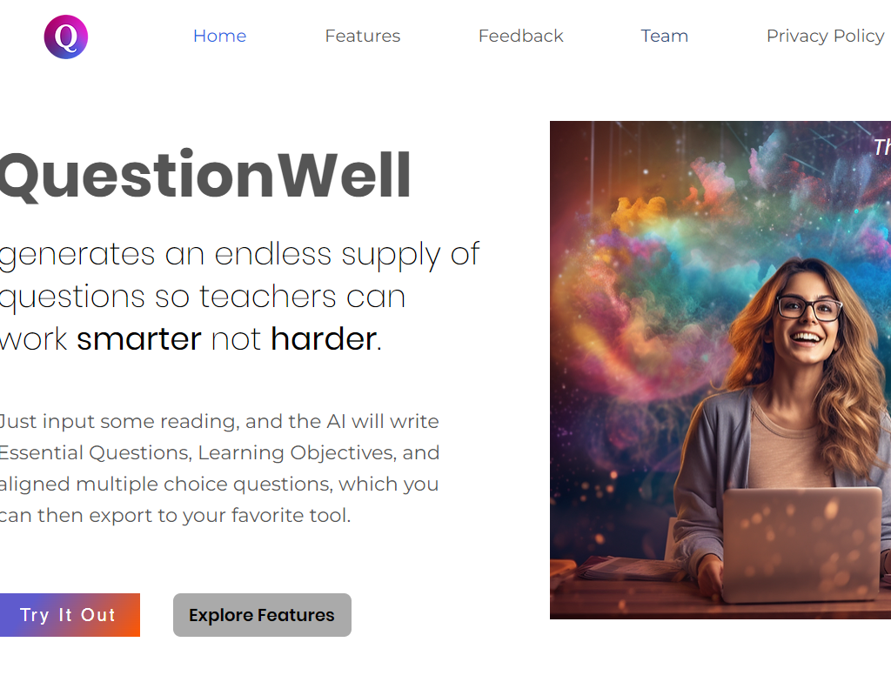
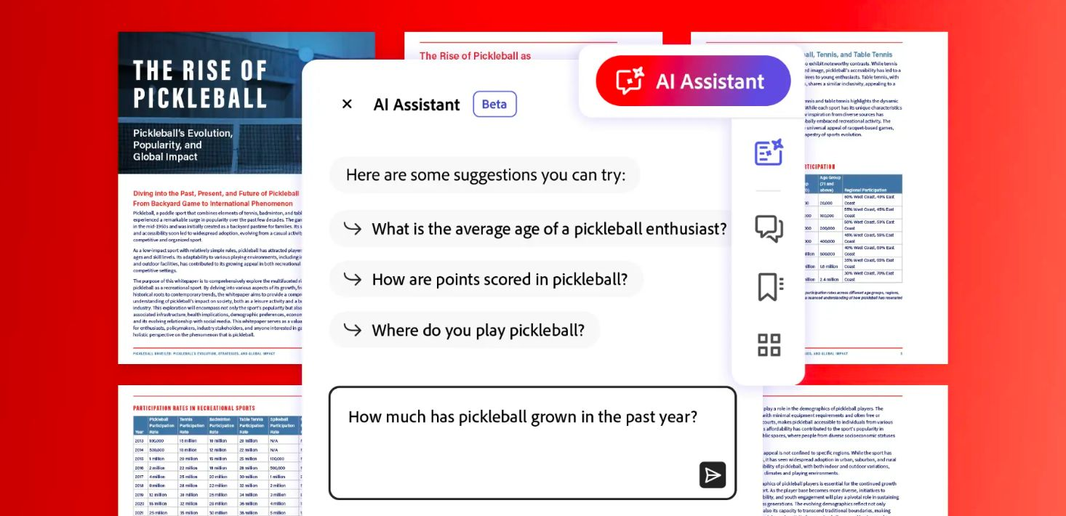
Bonus tip
Adobe Acrobat & Question Well

Slide 24
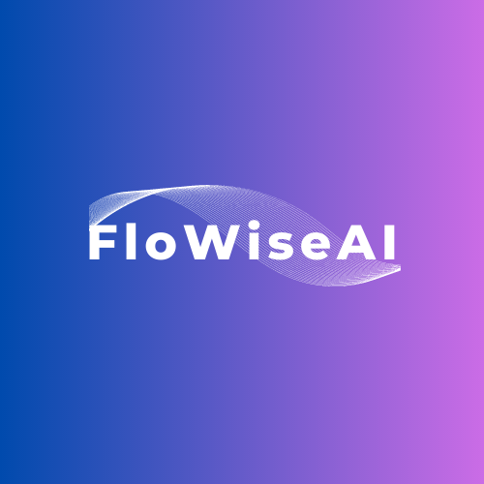
Custom GPTs
OpenAI GPT’s
Cogniti Agents
FlowiseAI Chatbots
Feedback bot→
(for those interested)
Notes:
Who pays the bills, why?

Slide 25
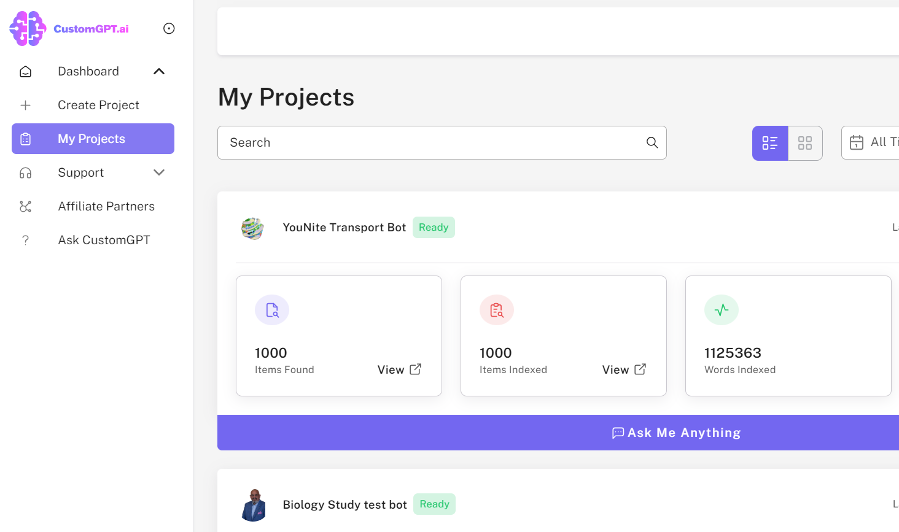
Custom GPTs
Reduce administration burden

Slide 26
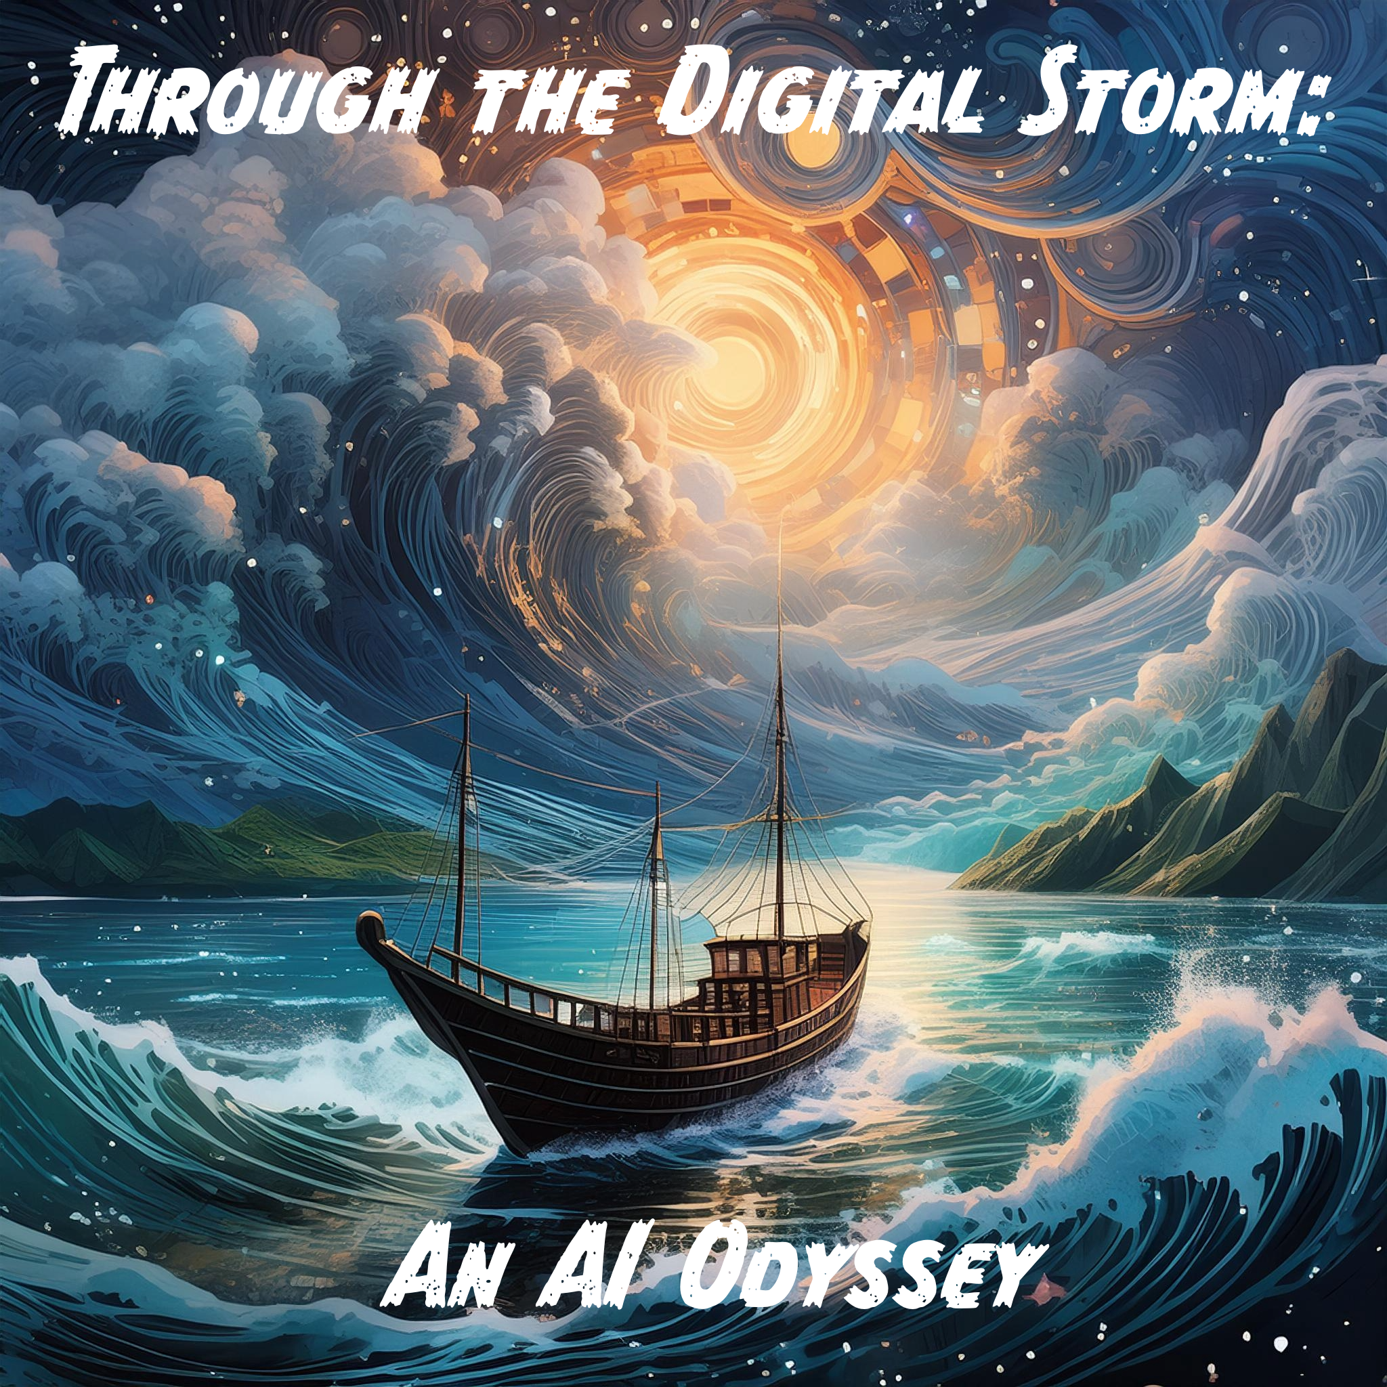
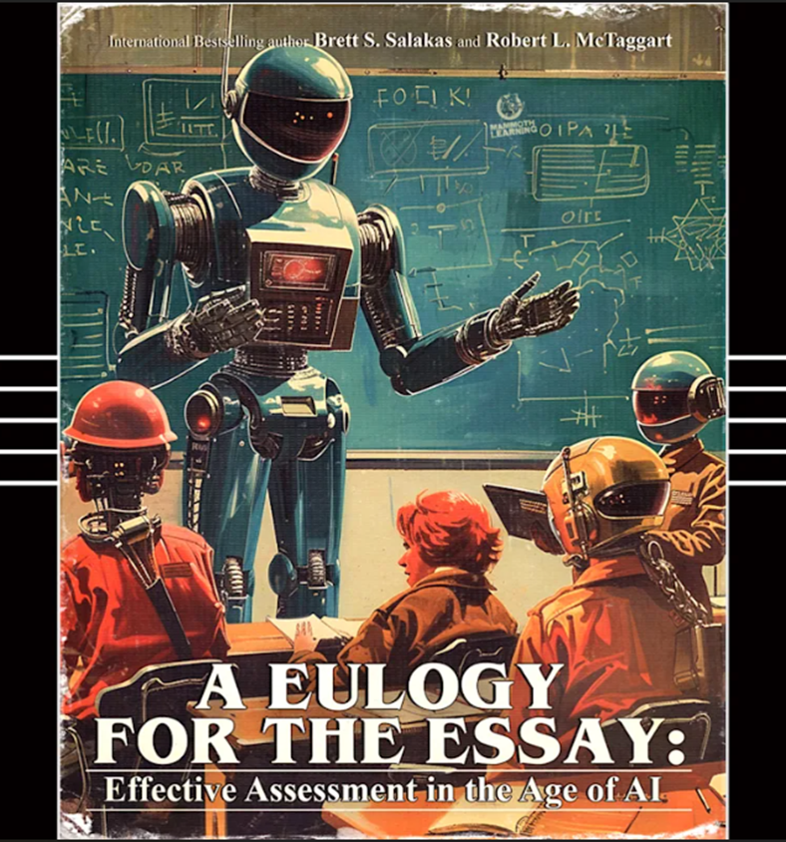
A poem to fin.
Share your feedback and thoughts with us by writing to: brett.salakas@hp.com and rob@slameducation.com

Slide 27
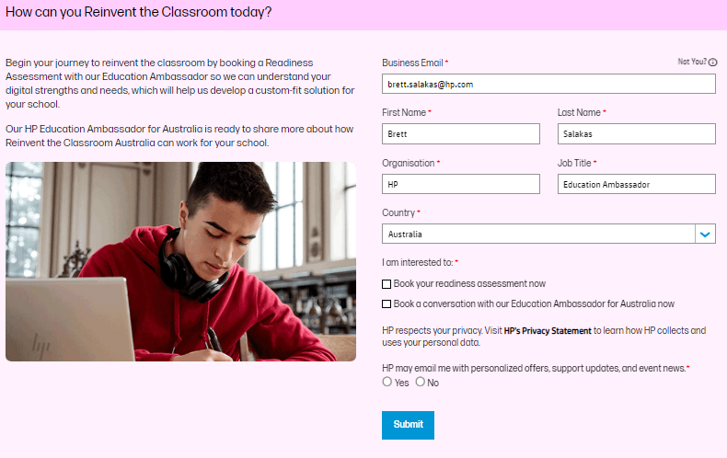
Reinvent the Classroom
reinvent.hp.com/RTC-ANZ

