Slide 2
My Second Favourite
“F”
Word is Free

Slide 3
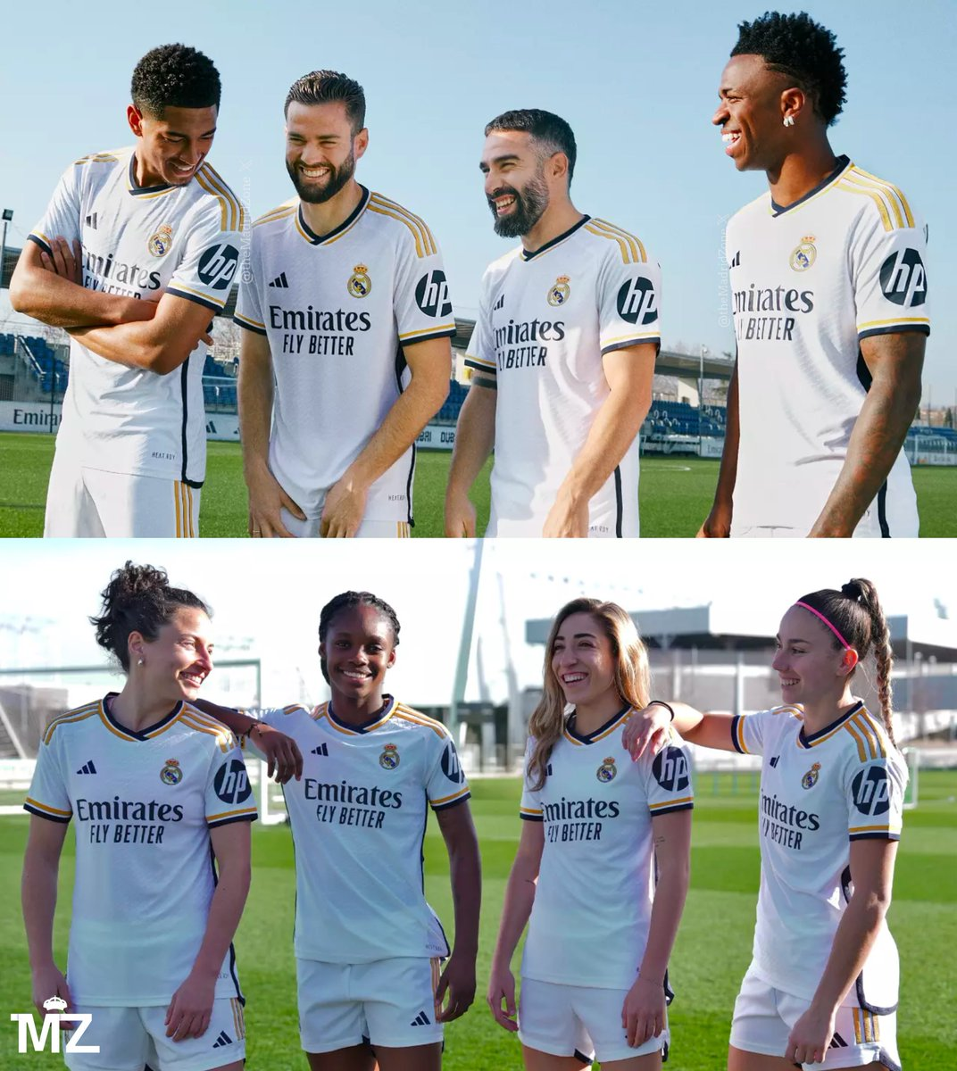
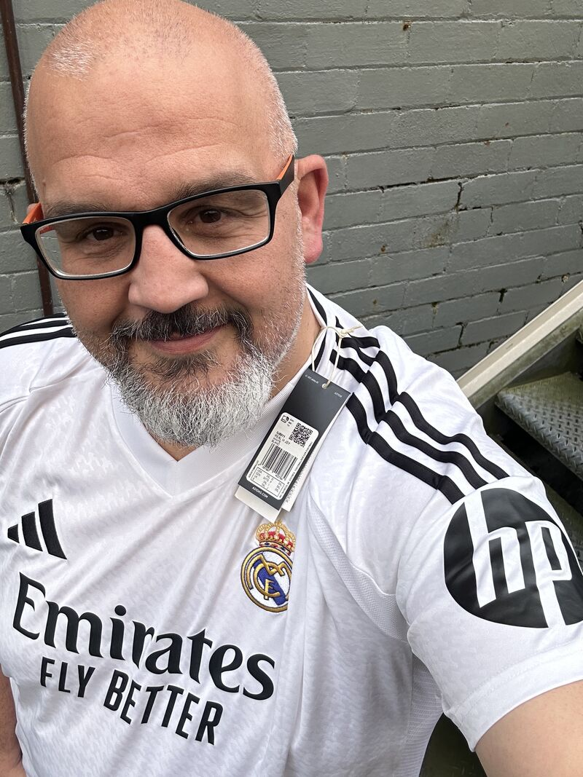

Slide 4
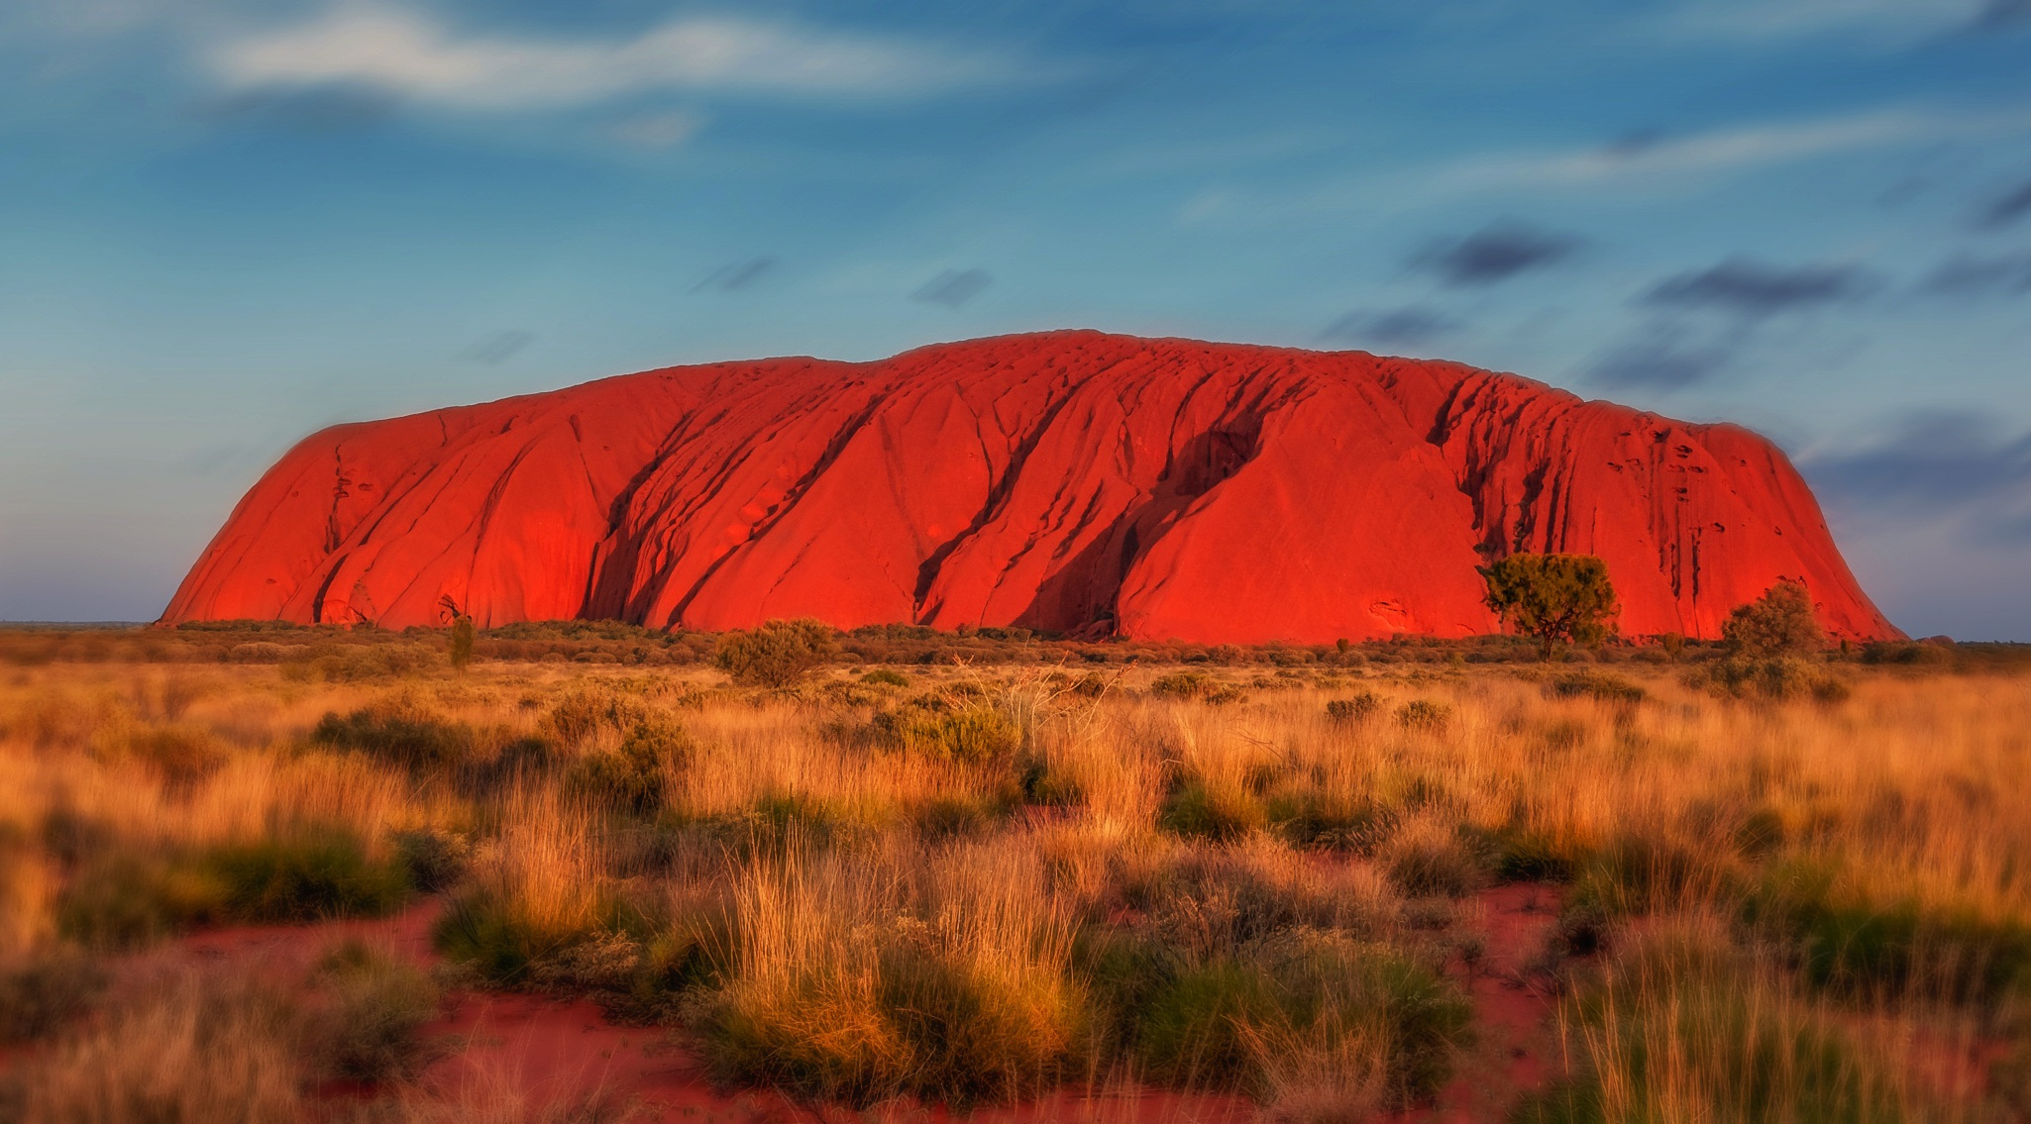
salakas.me/uluru
My Second Favourite
“F”
Word is Free
Digital Pedagogy
Enabling learning experiences that were previously impossible

Slide 5
Kar AI oke

Slide 6
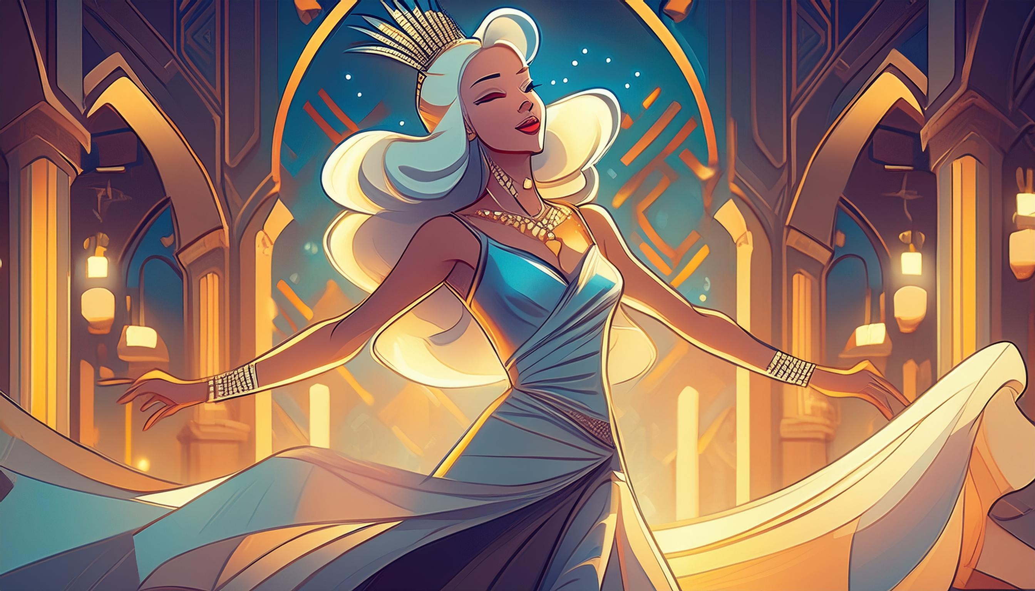
KarAIoke #1

Slide 7
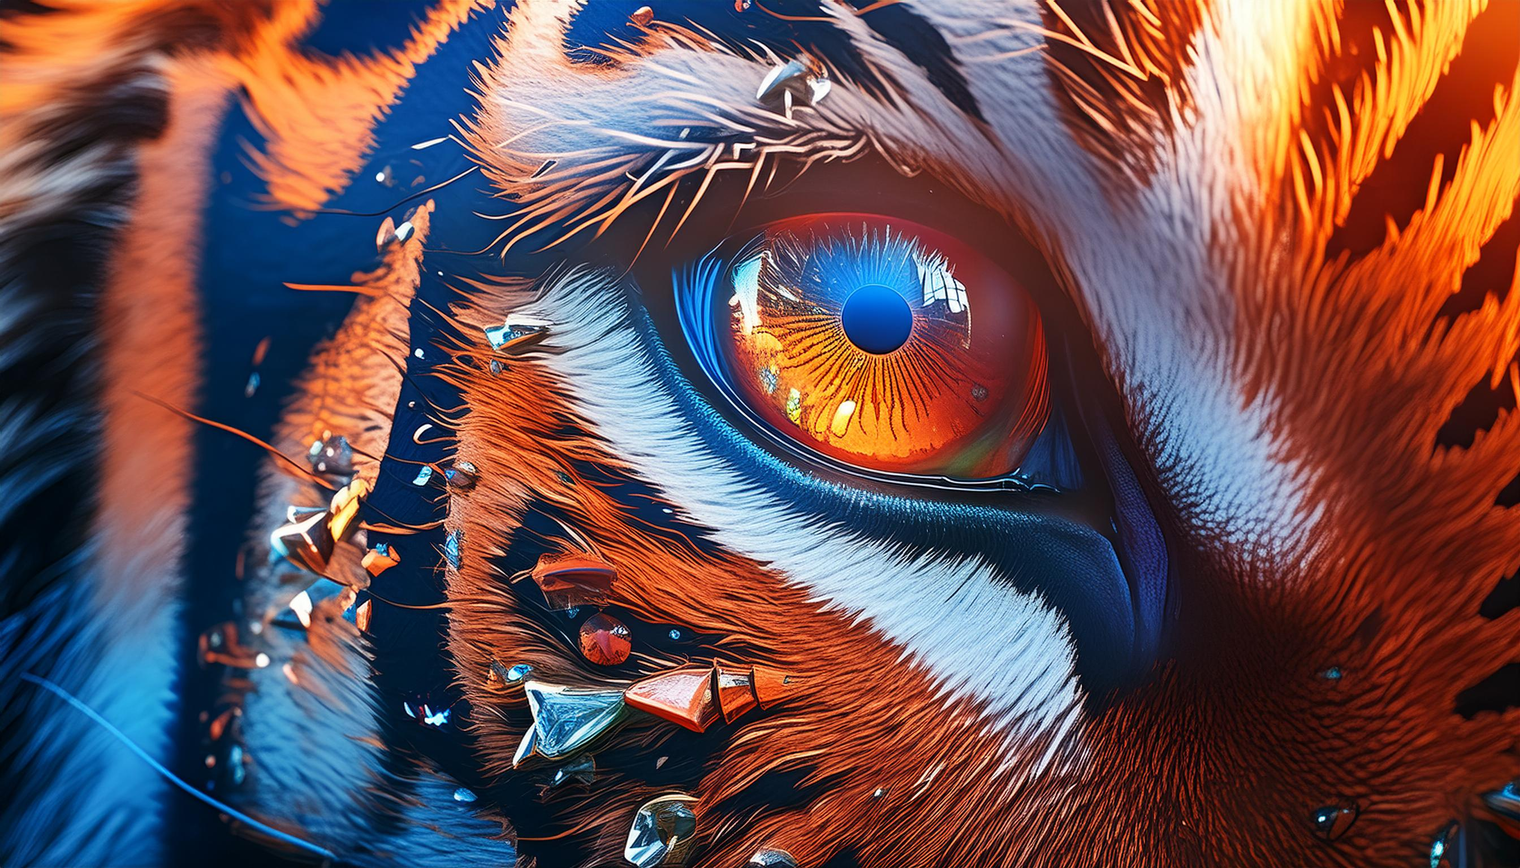
KarAIoke #2

Slide 8
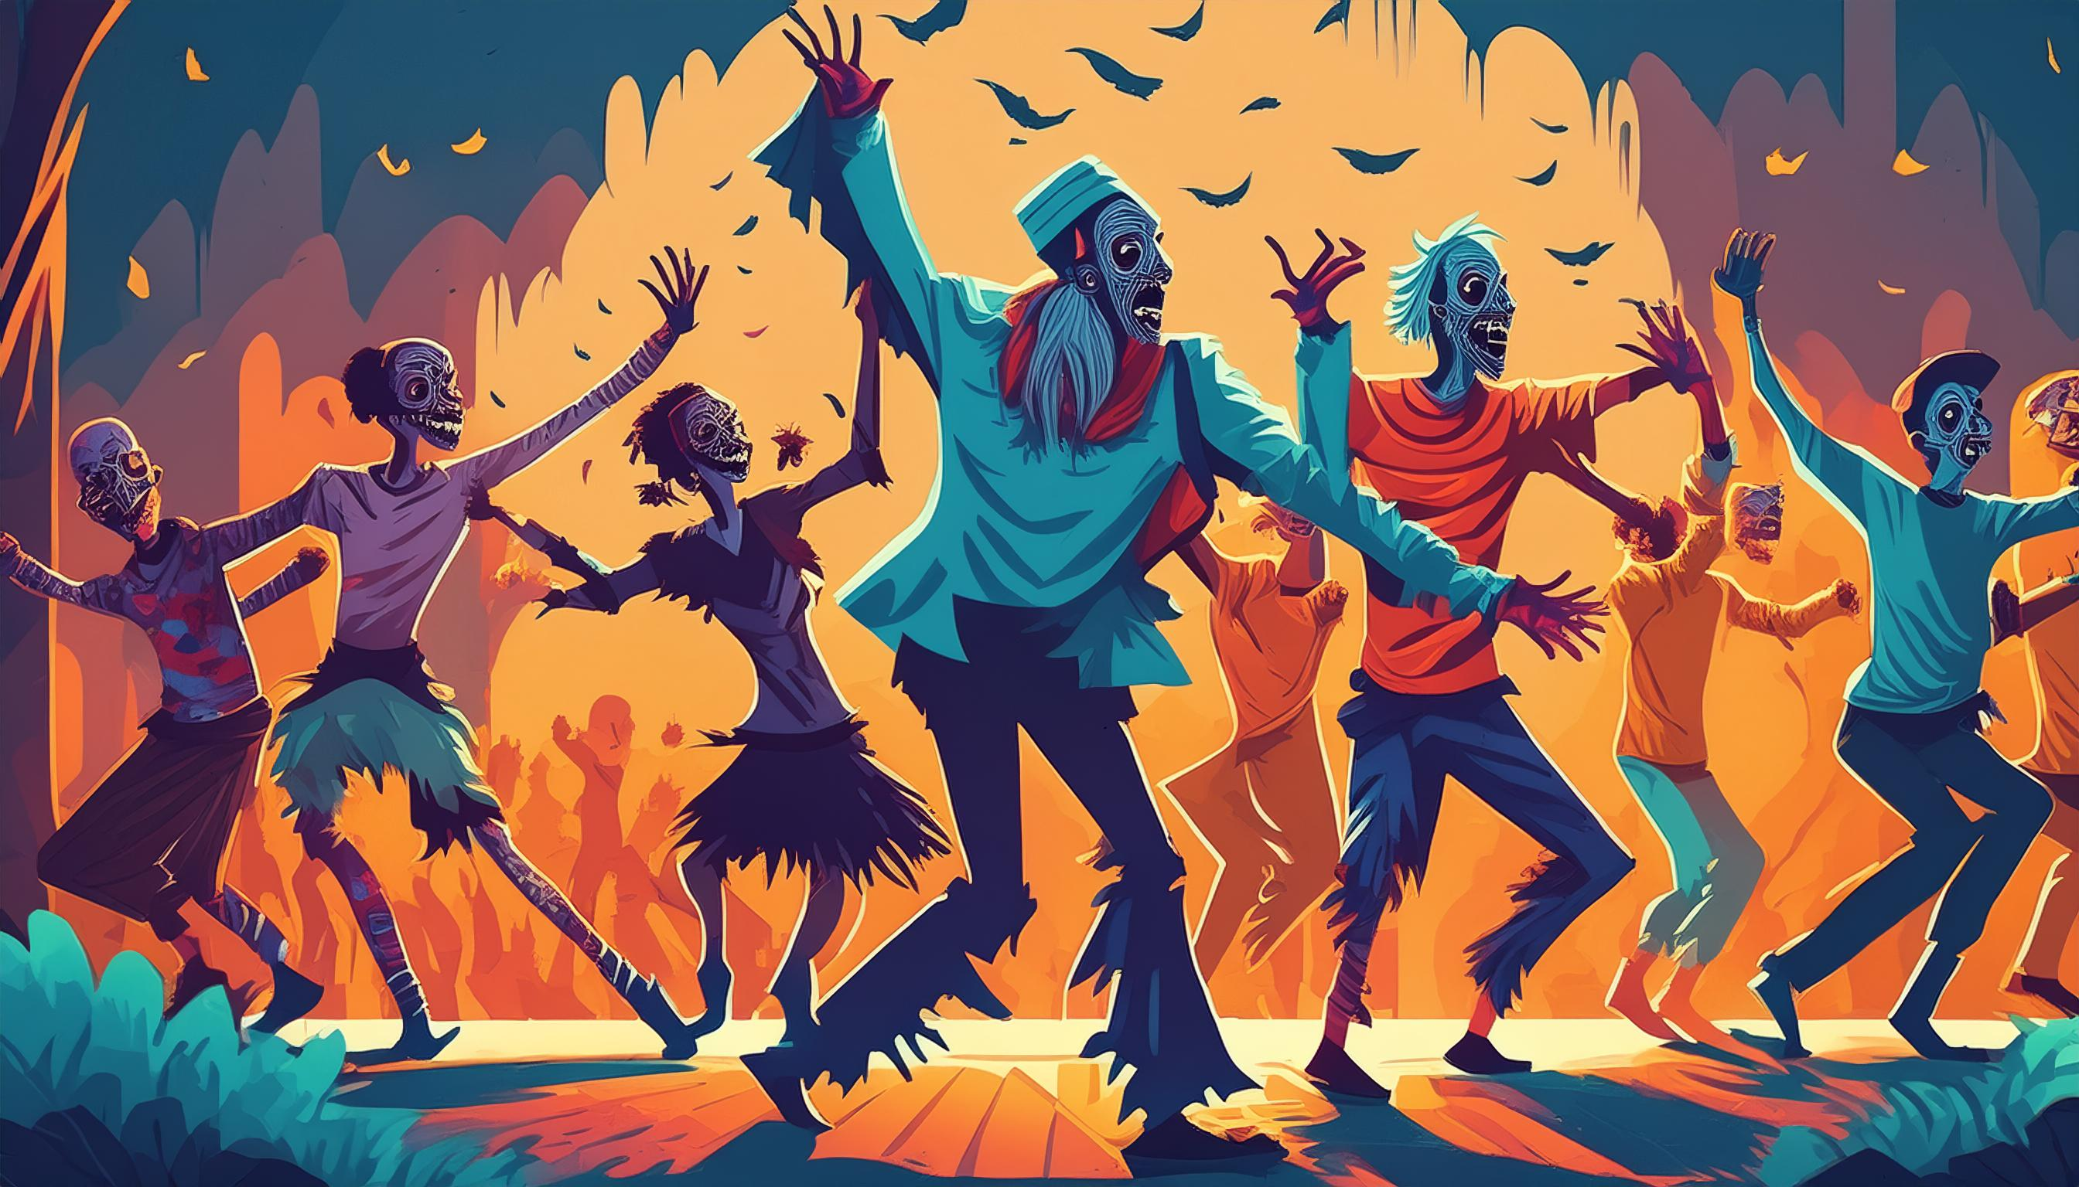
KarAIoke #3

Slide 9
KarAIoke #4

Slide 10
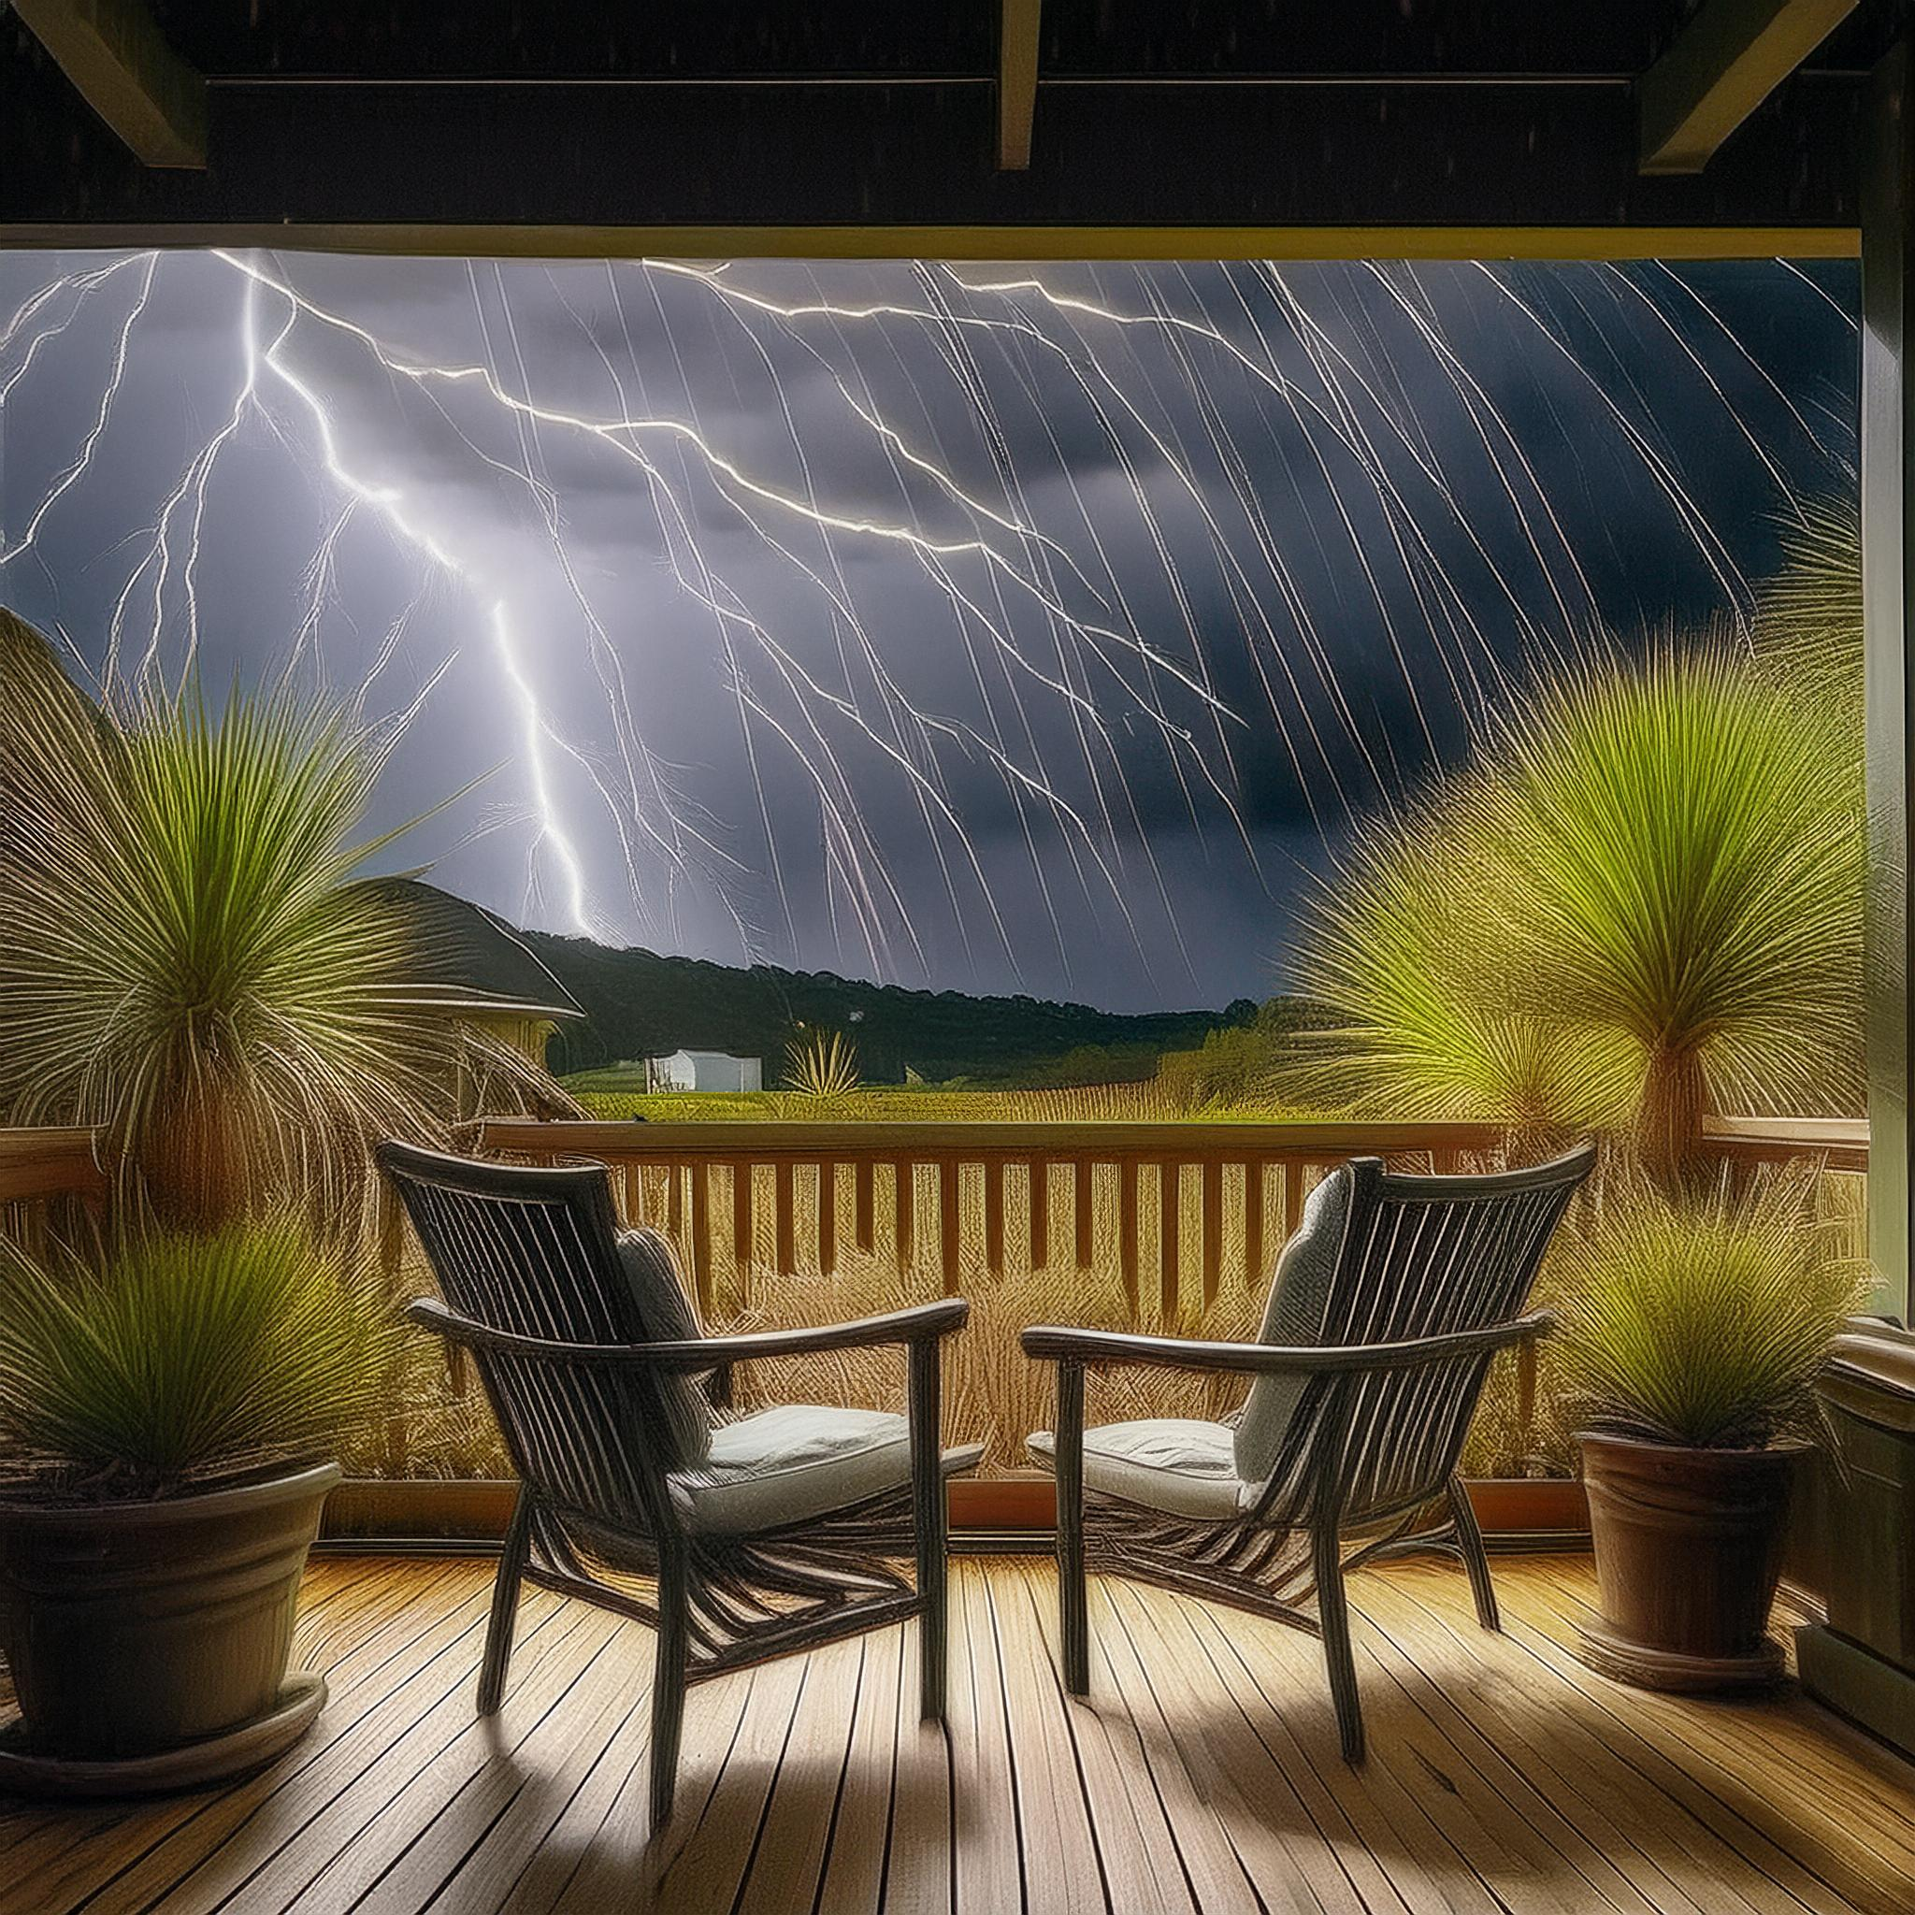
KarAIoke #5

Slide 11
KarAIoke #6

Slide 13
Calling all Superstars! 🎉
Personalized Feedback
Voice and
Interaction
Applications now open at snorkl.app!

Slide 14
Just like Roy Kent, Snorkl AI feedback is everywhere - providing timestamped insights on student videos. Because excellence knows no bounds.

Slide 18
Audiopen

Slide 22
Adobe Podcast

Slide 23
Adobe
Animate Audio

